Slide 1
Alarm System Simulation
Mattia Sacchi 2025 306499@studenti.unimore.it

Slide 2

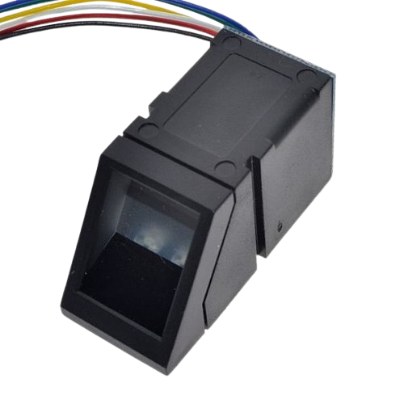
Sensors
Infix sensor (Window/Door)
Touch sensor (Fingerprint)

Slide 3

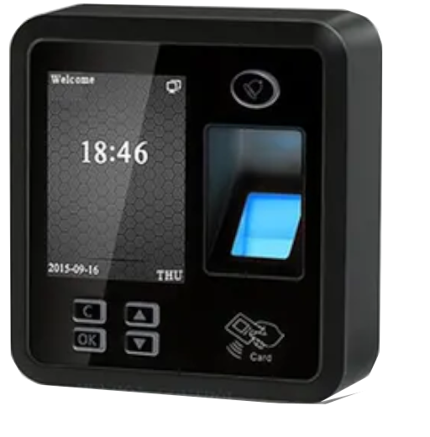
Actuators
Alarm switch (toggle)
Alarm controller (siren)

Slide 4



Project Description
Data Collector and Manager
Logic
> Time to join/exit the smart home (30 seconds)
Automated tests > Client simulation

Slide 5
Now, let’s see the code
Talk is cheap. Show me the code.
~ Linus Torvalds
Mattia Sacchi 2025 306499@studenti.unimore.it

